Slide 1
Introduktion til Programmering og Problemløsning (PoP)
Jon Sporring
Department of Computer Science
2020/09/07

Slide 2
Virkefelter (scope)
Navne (i yderste virkefelt) kan ikke overskrives
let name = "World"
let name = "Jon"
do printfn "Hello %s" name
name = "Jon" greeting = "Hello"
name = "Anders"
...
...
0
1
2
...
Virkefelter via parenteser
0
let greeting = "Hello"
let name = "Jon"
do printfn "%s %s" greeting name
(
let name = "Anders"
do printfn "%s %s" greeting name
)
do printfn "%s %s" greeting name
1

Slide 3
Syntaks og virkefelter
Letvægtssyntaks
verbose syntaks
let name = "World"
do printfn "Hello %A" name
let name = "World" in do printfn "Hello %A" name
Valgfrit ’do’
let name = "World"
printfn "Hello %A" name

Slide 4
Funktioner
Organisering = nemmere at forstå og vedligeholde
let greetings (name : string) : string =
"Hello " + name
> let greetings (name : string) : string =
- "Hello " + name;;
val greetings : name:string -> string
Leksikografisk virkefelt
Indryk angiver funktionskroppen
let greetings name =
"Hello " + name
let str = greetings "Jon"
printfn "%s" str
printfn "%s" (greetings "World")
let greetings name = "Hello " + name
let greetings name : string = "Hello " + name
let greetings (name : string) = "Hello " + name

Slide 5
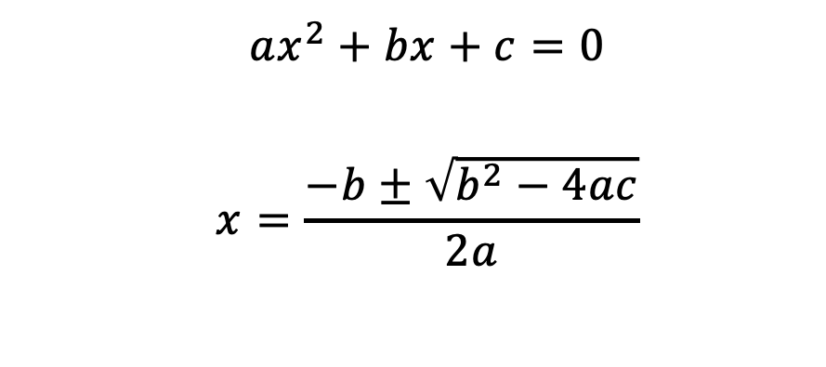
Løs en andengradsligning (baglæns!)
let discriminant a b c =
b ** 2.0 - 4.0 * a * c
let solution a b c sgn = -3.4
$${ax}^{2}+bx+c=0$$
$$x=\frac{−b±\sqrt{b^{2}−4ac}}{2a}$$
let solution a b c sgn =
let d = discriminant a b c
(-b + sgn * sqrt d) / (2.0 * a)
Mockup funktion
let a = 1.0
let b = 0.0
let c = -1.0
let xp = (solution a b c +1.0)
printfn "0 = %fx^2 + %fx + %f => x_+ = %f" a b c xp

Slide 6
Resumé
I denne video hørte du om:
Letvægts og verbose syntaks
Virkefelter
Funktioner

